Slide 1

Chemistry: CHEM 201TH
CARBOHYDRATES
Department of Chemistry
Government College
Paonta Sahib (HP)

Slide 2
Today’s Lecture
Epimerisation of Aldose i.e. conversion of D-glucose into D-mannose
Limitations of the open chain structures
Ring structure of glucose
Evidence in favour of ring structure

Slide 3
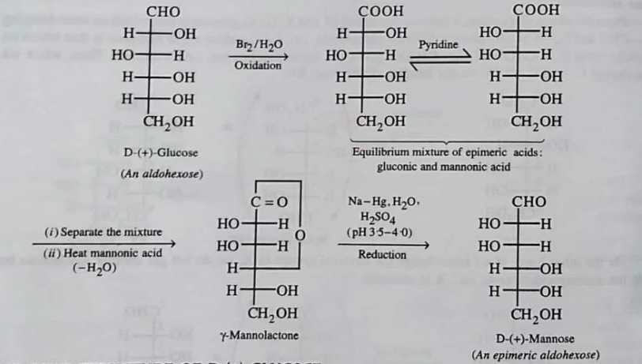
Epimerisation of Aldose i.e. conversion of D-glucose into D-mannose
Epimerisation: One of two molecules that differ in the spatial arrangement of atoms or groups surrounding only one of two or more chiral atoms in the structure
If an aldole is oxidised by bromine water to give corresponding aldonic acid, which on further heating with pyridine gives a mixture of original acid and epimeric form.
Epemeric acids are seprated and then heated to corresponding γ-lactone which is on subsequent reduction with sodium amalgam and water gives the epimeric aldose.

Slide 4
Limitations of the open chain structures of Glucose
Open chain structure of D-glucose failed to explain the following facts
D-glucose does not undergo certain characteristic reactions of aldehydes, e.g. reaction with NaHSO₃, NH₃ and Schiff’s reagent test.
D-glucose reacts with hydroxyl amine while penta-acetate of glucose does not react indicates the absence of aldehydic group in glucose penta-acetate.
Thje UV spectrum of D-glucose does not show the presence of aldehydic group.

Slide 5
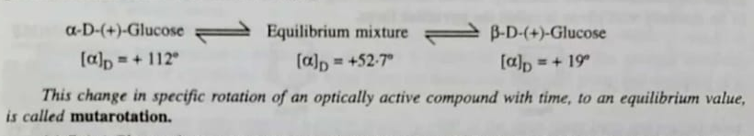
D-glucose exists in two stereo isomeric forms viz. α-D(+)-glucose & β-D-(-)-glucose. if a solution of β-D-(-)-glucose is dissolved in water, its specific optical rotation will be +18.7°. Over time, some of the β-D-(-)-glucose will undergo mutarotation to become α-D(+)-glucose, which has an optical rotation of +112.2°. The rotation of the solution will increase from +18.7° to an equilibrium value of +52.7° as some of the β form is converted to the α form. The equilibrium mixture is about 64% of β-D-glucopyranose and about 36% of α-D-glucopyranose

Slide 6
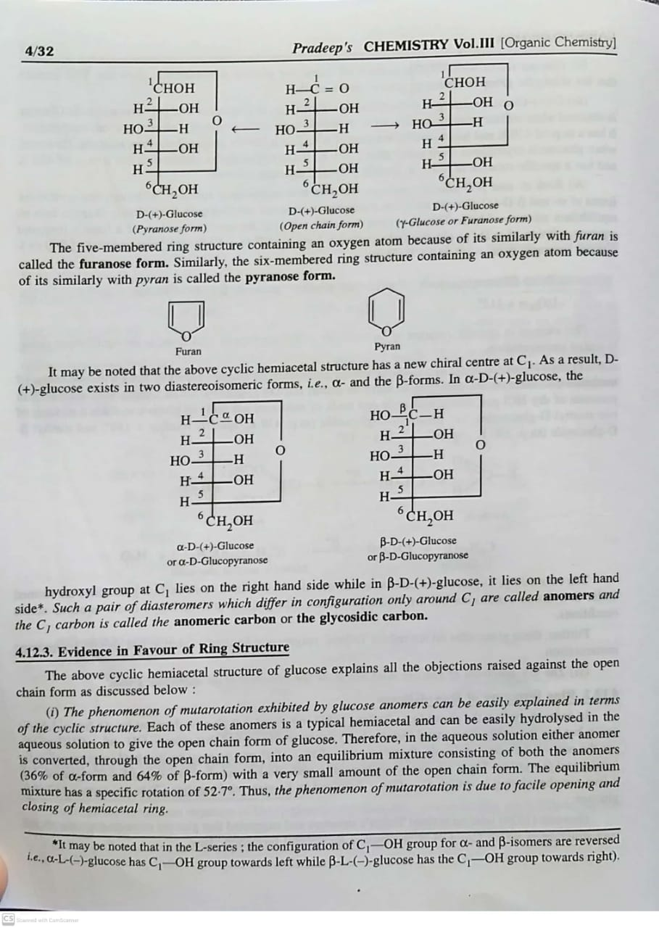
Ring Structure of D-(+)-Glucose
Tollen (1883) suggested that glucose does not have a free aldehydic group but has the cyclic hemiacetal structure. He argued that since -OH and -CHO groups are the part of the same molecule. Therefore, any of the -OH groups may be involved in intramolecular hemiacetal formation. Haworth (1926) later on revised the structure and suggested that glucose contains a six-membered ring structure in which C₅-OH is involved in hemiacctal formation.

Slide 7
α and β Forms of D-(+)-Glucose

Slide 8
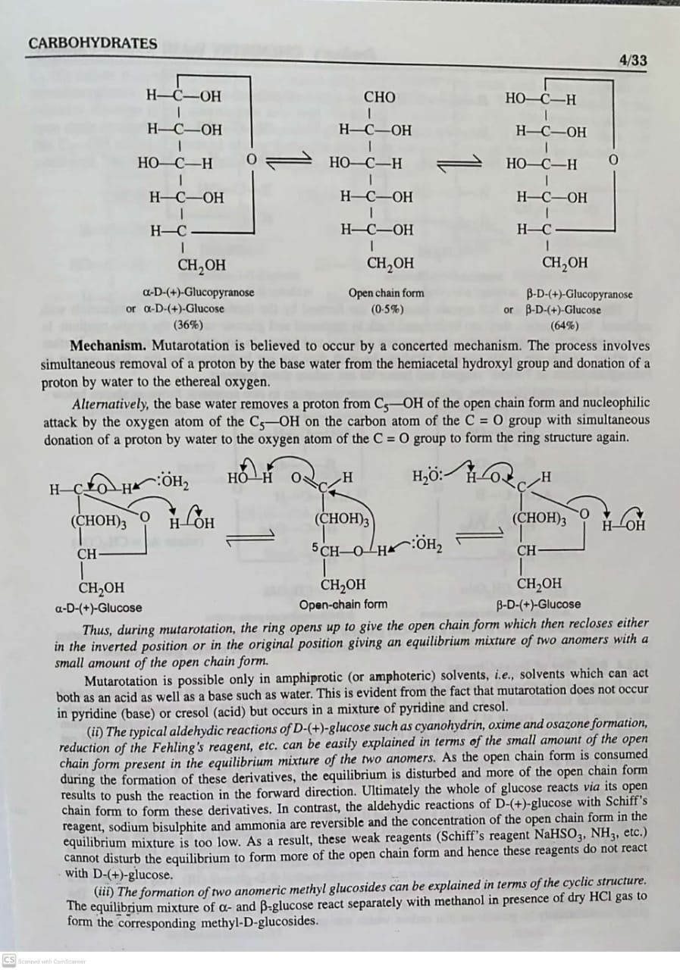
Evidence in favour of Ring Structure of D-(+)-Glucose
(I) The phenomenon of mutarotation exhibited by glucose anomers can be explained due to facile opening and closing of hemiacetal ring.

Slide 10
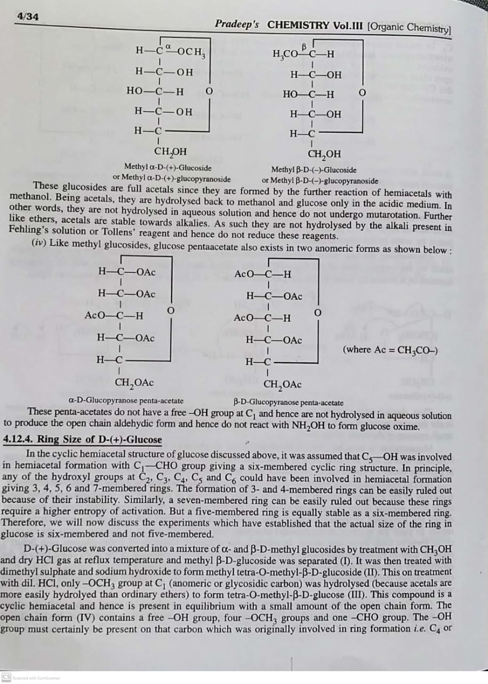
(II) The typical aldehydic reactions of D-(+)-glucose such as cyanohydrin, oxime and osazone formation, reduction of the Fehling’s reagent, etc. can be easily explained in terms of the small amount of the open chain form present in the equilibrium mixture of the two anomers.
(III) The formation of two anomeric methyl glucosides can be explained in terms of cyclic structures.

Slide 12
Next Lecture
Ring Size of D-(+)-Glucose
Haworth Projection Formulae of α and β Forms of D-(+)-Glucose

Slide 13
Thank You

